Slide 1
SMART POWER AUTOMATION
KAAROKKI. R-210701101
KEERTHIKA. V-210701121
LAKSHME KAARTHIKAA. S-210701129

Slide 2
ABSTRACT
This project proposes an Internet of Things (IoT) based solution for power management in rooms, aiming to minimize energy wastage when spaces are unoccupied. The system employs a network of sensors to detect human presence within a room. Upon detecting no occupants, it triggers an automatic shutdown of non-essential electrical devices and lighting to conserve energy. The implementation involves using sensors such as passive infrared (PIR) sensors or ultrasonic sensors to detect the presence of a person within the room. When a person enters the room, the sensor detects the motion or presence and triggers a microcontroller-based control unit. This control unit is programmed to actuate a relay or switch mechanism that disconnects the power supply to the room's electrical outlets. Conversely, when the room is empty, and no motion or presence is detected for a specified period, the control system reverts to its default state, restoring power to the outlets. This automated functionality eliminates the need for manual intervention to switch off lights or appliances when leaving a room, promoting energy conservation and reducing electricity costs. The project integrates hardware components such as sensors, a microcontroller (e.g., Arduino or Raspberry Pi), and a relay circuit. Software programming is implemented to manage sensor inputs, decision-making logic, and relay control. By seamlessly integrating presence detection with power management, the system contributes to sustainability efforts and offers a user-friendly approach to energy conservation in residential, commercial, and industrial settings.

Slide 3
INTRODUCTION
The “SMART POWER AUTOMATION” proposes the development of an Automatic Power Supply Control System based on presence detection. This system offers a practical solution to automatically manage the power supply in rooms by detecting the presence or absence of individuals. When a person enters a room, the system activates, ensuring that power is available for use. Conversely, when the room becomes unoccupied, the system intelligently turns off the power supply to conserve energy. This system will contribute to energy conservation efforts by ensuring that power is only supplied to rooms or areas when they are occupied, thereby reducing unnecessary electricity consumption and promoting sustainability. The project aims to demonstrate a practical and effective solution for reducing energy waste in indoor settings while enhancing user convenience. The smart power automation system will showcase the application of IoT technology in promoting sustainable energy practices and contribute towards creating more efficient and environmentally-friendly power management systems.

Slide 4
LITERATURE SURVEY
"Smart Power Automation: A Literature Review“
This survey paper examines cybersecurity challenges and solutions in smart power grids. It discusses the threat landscape, vulnerabilities, and attack vectors facing modern power systems, including IoT devices, communication networks, and control systems. The survey reviews cybersecurity technologies, protocols, and best practices for securing smart grids against cyber threats, emphasizing the importance of risk assessment to safeguard critical infrastructure and ensure grid resilience.
"Survey on IoT Integration in Power Systems: A Research Paper"
The survey analyzes recent advancements, challenges, and future directions in AI/ML-based EMS, highlighting the potential for improved grid operations, cost savings, and environmental impact through intelligent energy management strategies..
"Survey on Cybersecurity in Smart Power Automation"
It discusses the challenges, opportunities, and emerging trends in IoT-enabled power automation, including sensor networks, data analytics, control algorithms, and communication protocols. The survey also examines case studies and real-world implementations of IoT solutions in power grids, highlighting the benefits and challenges of IoT integration for improving grid reliability, efficiency, and sustainability..

Slide 5
PROBLEM STATEMENT
The “SMART POWER AUTOMATION” project addresses the problem of energy wastage due to inefficient power management in indoor environments. One common issue is the unnecessary consumption of electricity when rooms are unoccupied, leading to increased utility costs and environmental impact. Manual methods of switching off lights and devices upon exiting a room are prone to oversight and inconvenience.

Slide 6
PROPOSED SYSTEM
The proposed system integrates IoT technology with human detection sensors to enable smart power management. The aim of “SMART POWER AUTOMATION” is to develop an Automatic Power Supply Control System that intelligently manages electricity usage in indoor environments by automatically controlling the power supply based on detected human presence.Using motion or presence sensors, the system detects human presence in a room or area. When humans are detected, the system turns on the power supply to activate lights, appliances, or devices. Conversely, when no human presence is detected for a specified period, the system automatically turns off the power supply, conserving energy. This smart power on/off system enhances convenience, energy efficiency, and automation in residential, commercial, or industrial settings, contributing to sustainable and intelligent power management.

Slide 7
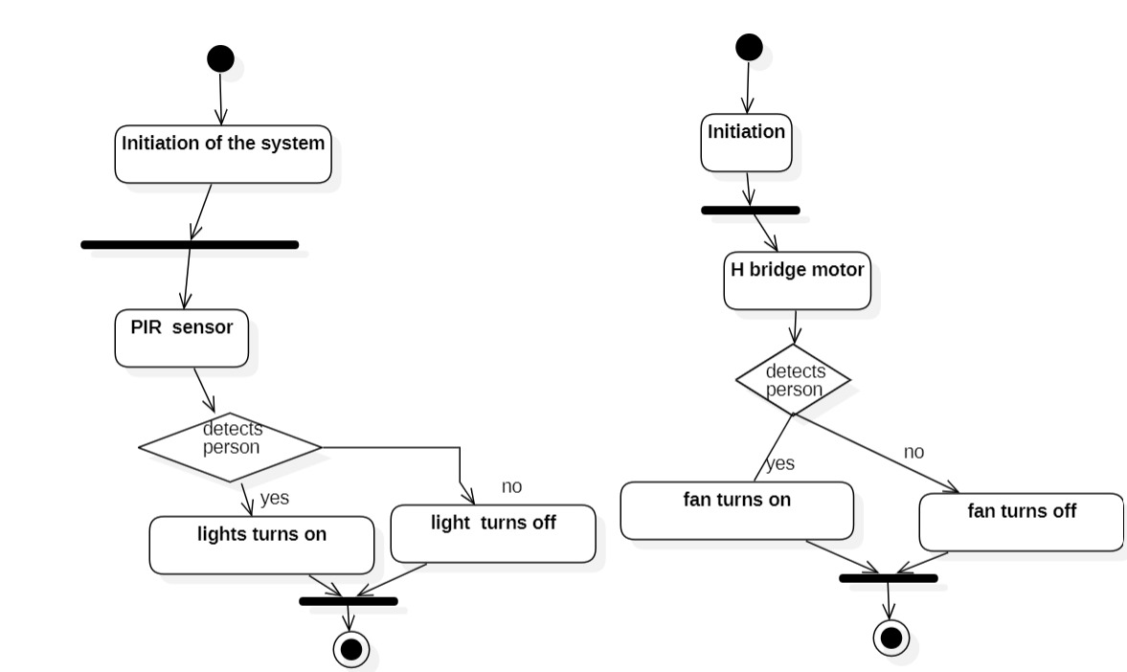
SYSTEM FLOWCHART

Slide 8
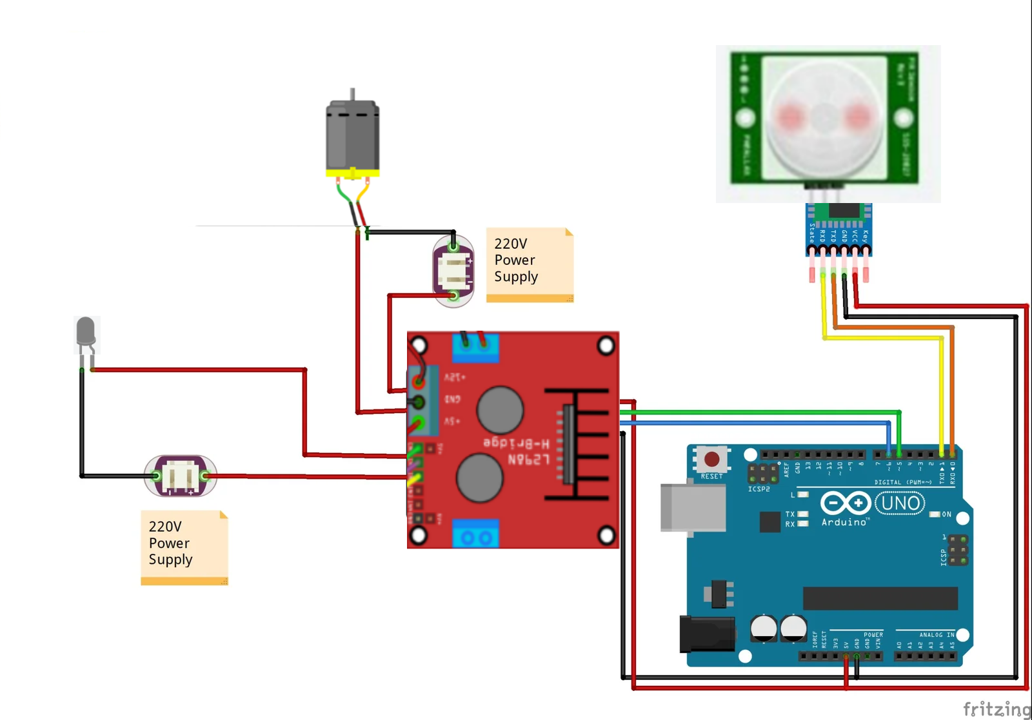
CIRCUIT DIAGRAM

Slide 9
METHODOLOGY
The proposed model for the Smart power automation System integrates e technology to revolutionize urban power infrastructure. At its core lies the Arduino Uno microcontroller, serving as the system's central processing unit (CPU). This is a microcontroller setup for the smart power automation system which acts as the CPU of the whole system. tart by designing a circuit where a PIR (Passive Infrared) sensor detects motion and a relay module controls an electrical appliance. Connect the PIR sensor to the Arduino, with its Vcc to the 5V pin, GND to GND, and Output to a digital input pin (e.g., pin 2). Similarly, connect the relay module, with its Vcc to the 5V pin, GND to GND, and signal pin to a digital output pin (e.g., pin 8). Wire the appliance to the relay module, linking one terminal to the Normally Open (NO) relay terminal, and the other terminal to the power source, completing the circuit via the Common (COM) relay terminal. Next, write the Arduino code to initialize the PIR sensor and relay module, continuously monitor the PIR sensor's output, and activate the relay when motion is detected, thus turning on the appliance. If no motion is detected for a specified period, the relay deactivates, turning off the appliance. Use a breadboard for initial prototyping to verify connections.Once verified, transfer the circuit to a more permanent setup if needed. During testing, calibrate the PIR sensor's sensitivity and delay to ensure optimal performance. Deploy the system by mounting the PIR sensor where it has an unobstructed view of the room entrance, securing all connections, and connecting to a stable power source.

Slide 10
RESULT
The implementation of a smart power automation system using an Arduino and a microcontroller successfully automated the control of electrical appliances based on room occupancy. The system utilized a PIR (Passive Infrared) sensor to detect motion, which triggered a relay module connected to the Arduino, thereby controlling the power supply to the appliance. When a person entered the room, the PIR sensor detected the motion, and the Arduino processed this input to activate the relay, turning on the appliance. Conversely, the appliance was turned off when no motion was detected for a set period, ensuring energy efficiency. During testing, the system reliably detected human presence and responded promptly by switching the appliance on and off, validating the effectiveness of the PIR sensor and the relay control. Calibration of the PIR sensor allowed adjustments to its sensitivity and delay time, optimizing performance for different room sizes and occupancy patterns. Deployment involved securely mounting the PIR sensor to ensure a clear line of sight for accurate motion detection and ensuring all electrical connections were stable and insulated to prevent short circuits. The system was connected to a stable power source, providing consistent operation. This project demonstrated significant potential for reducing energy consumption by ensuring appliances were only active when needed.

Slide 11
CONCLUSION
In conclusion, the development of smart power automation has successfully demonstrated the feasibility and effectiveness of using IoT technologies to optimize energy usage in indoor environments. By automatically managing power supply based on human presence detection, the system significantly reduces energy waste and contributes towards sustainability efforts. Throughout the project, key objectives including sensor integration, control unit development, and power management optimization were achieved, resulting in a functional prototype that showcases the potential benefits of automated power control systems. Looking ahead, several enhancements can be implemented to further enhance the capabilities and usability of the Automatic Power Supply Control System. Future developments could focus on integrating machine learning algorithms to predict occupancy patterns and optimize power management strategies accordingly. Additionally, expanding the system's compatibility with smart home platforms and mobile applications would improve user accessibility and control. Incorporating energy monitoring and analytics features would empower users with insights to make informed decisions about their energy consumption. Moreover, exploring alternative energy sources such as solar or wind power integration could further enhance the system's sustainability and reduce environmental impact. These future enhancements aim to transform the Automatic Power Supply Control System into a comprehensive and adaptable solution for efficient energy management in various indoor settings.

Slide 12
REFERENCE
[1] Saleh, M., Yuen, C., et al. (2013). Smart Grid Technologies: Communication Technologies and Standards. IEEE Transactions on Smart Grid, 4(2), 747-756.
[2] Hussain, Z. A., Alwadi, K. A., et al. (2019). Internet of Things (IoT) Applications in Power Systems: A Review. IEEE Access, 7, 162574-162593.
[3] Yazdi, H. S., Kermani, R. G., et al. (2019). Artificial Intelligence Techniques for Smart Grids: A Comprehensive Review. Sustainable Cities and Society, 51, 101724.
[4] Chen, X., Jiang, Y., et al. (2020). Cybersecurity in Smart Grids: A Review of Challenges and Solutions. IEEE Access, 8, 101929-101951. [5] Singh, R. R., Bansal, R. C., et al. (2021). Smart Power Grids: Challenges and Opportunities. Renewable and Sustainable Energy Reviews, 137, 110603

